Slide 1

Global EV Sales
Presented by-
Bhuvana Mandli
Radhika Kadaboina
Batch No. 493

Slide 2

Agenda
Business Problem
Project Objective
Project Flow
Dataset Overview
Project steps and screenshots
Business Insights and Recommendations
Conclusion

Slide 3
Business Problem
The Electric Vehicle (EV) market is rapidly growing across regions and technologies, making it difficult to analyze EV adoption trends, market growth, infrastructure development, and regional performance from raw data.
Businesses and policymakers need an interactive analytical solution to:
Track EV growth trends
Compare powertrain technologies
Analyze vehicle category performance
Monitor EV infrastructure
Identify future market opportunities
Without effective visualization and analytics, extracting meaningful insights from complex EV datasets becomes challenging.

Slide 4
Project Objective
Build an interactive Power BI dashboard named Global EV Sales
Analyze regional EV growth trends
Visualize EV sales and stock performance
Compare powertrain technologies (BEV, PHEV, FCEV)
Analyze vehicle category performance
Monitor charging infrastructure growth
Perform year-over-year EV growth analysis
Compare EV adoption across regions
Generate business insights for data-driven decision making

Slide 5
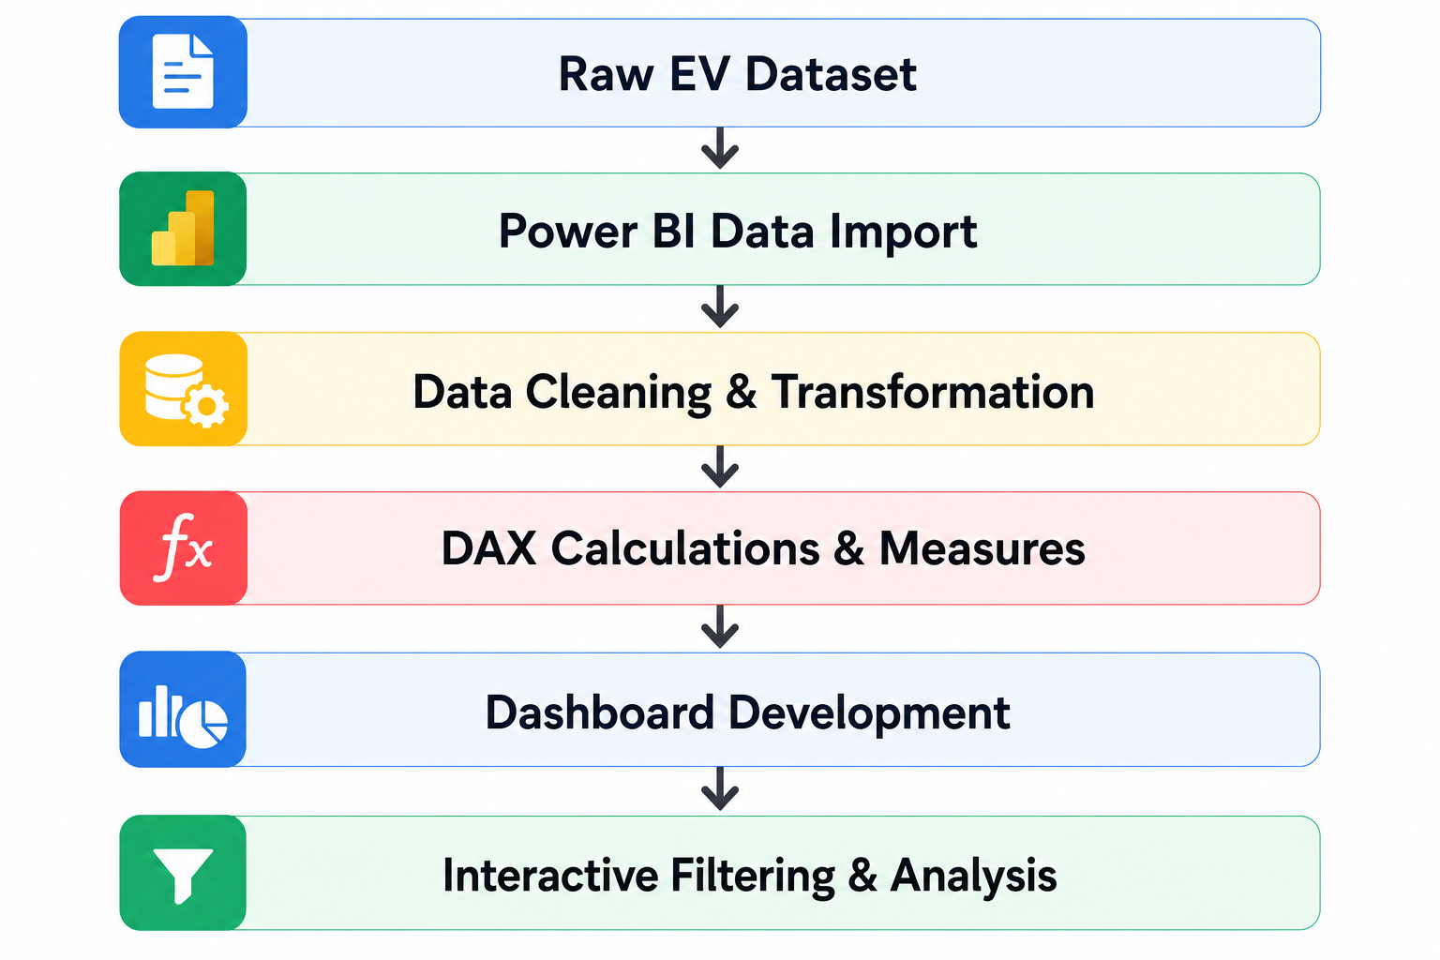
Project Flow

Slide 6
Dataset Overview
Dataset Fields
Column | Description
region | Country/region name
category | Historical and projected EV scenarios
parameter | EV sales, stock, charging points, etc.
mode | Vehicle type/category
powertrain | BEV, PHEV, FCEV, etc.
year | Reporting year
unit | Unit of measurement
value | Numeric EV metric value
Dataset Information
Total Records: 12,654

Slide 7
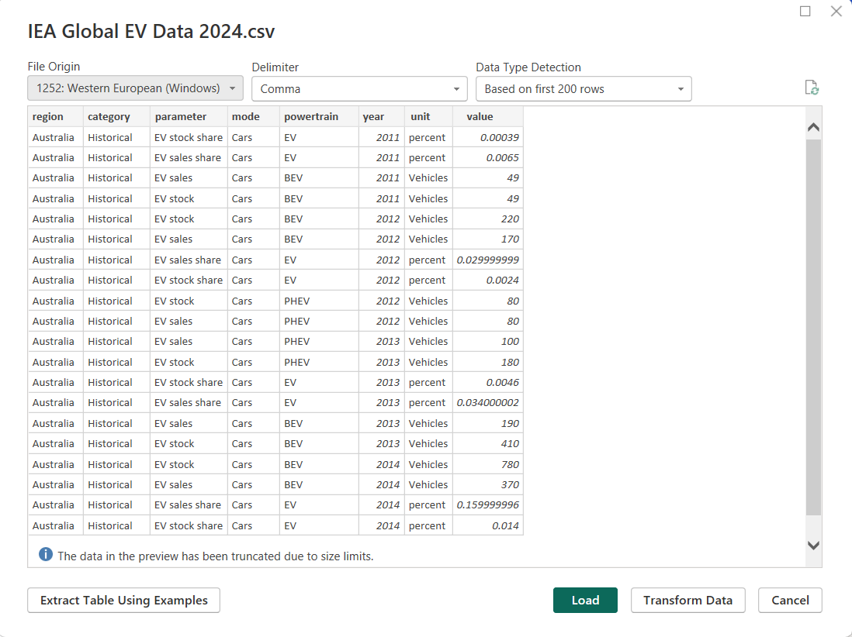
Project Steps and Screenshots
Uploading the Dataset
Process
Imported EV dataset into Power BI Desktop
Verified data types for all columns
Checked dataset structure and column consistency
Validated missing values
Tools Used
Power BI Desktop
Power Query Editor

Slide 8
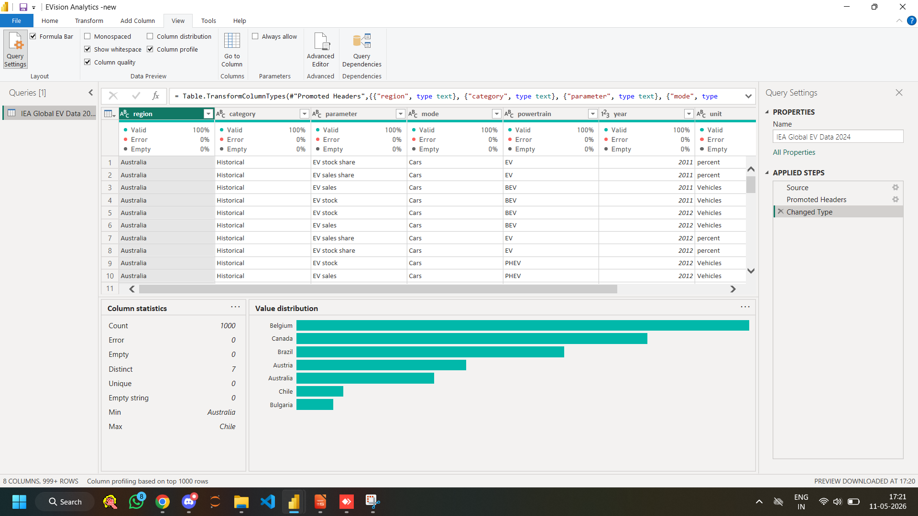
Data Cleaning & Transformation
Activities Performed
Removed null and unnecessary values
Verified data types
Created derived columns for analysis
Checked year-wise consistency
Power Query Operations
Change Data Types
Remove Errors
Replace Values

Slide 9
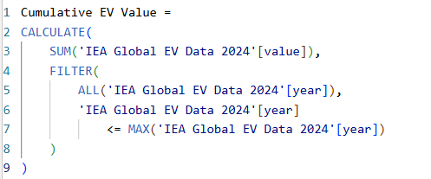
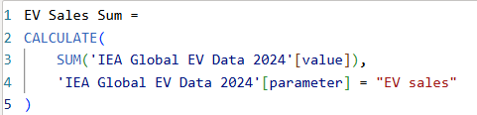
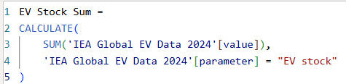
New Measures Created
Cumulative EV Value
Calculated cumulative EV growth across years
Used for time-series and growth trend analysis
EV Sales Sum
Calculated total EV sales values
Used for sales performance analysis
EV Stock Sum
Calculated total EV stock values
Used for EV adoption and stock trend analysis

Slide 10

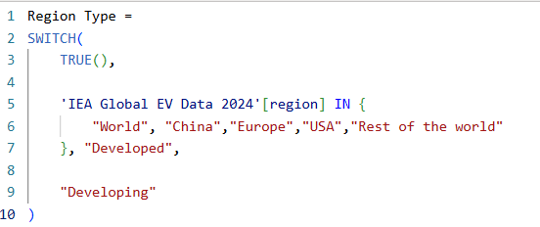
New Columns Created
Date Column
Created a Date column from the Year field to convert categorical years into proper date format
Used hierarchical year format to enable correct chronological sorting in Waterfall and time-series charts
Region Type
Classified regions into Developed and Developing categories
Used for comparative regional analysis

Slide 11
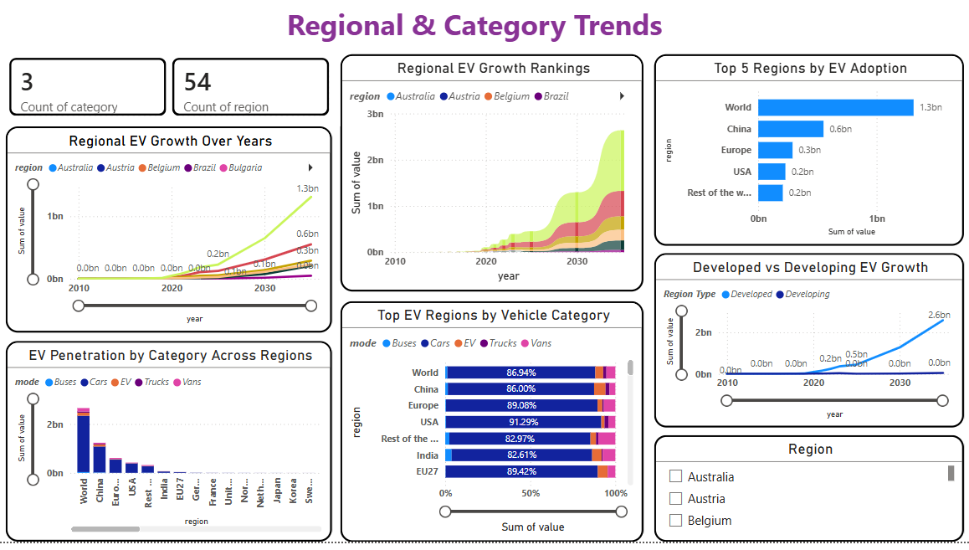
Key Dashboard Analysis
Regional Analysis
Top EV regions
Regional EV growth trends
Developed vs developing market comparison

Slide 12
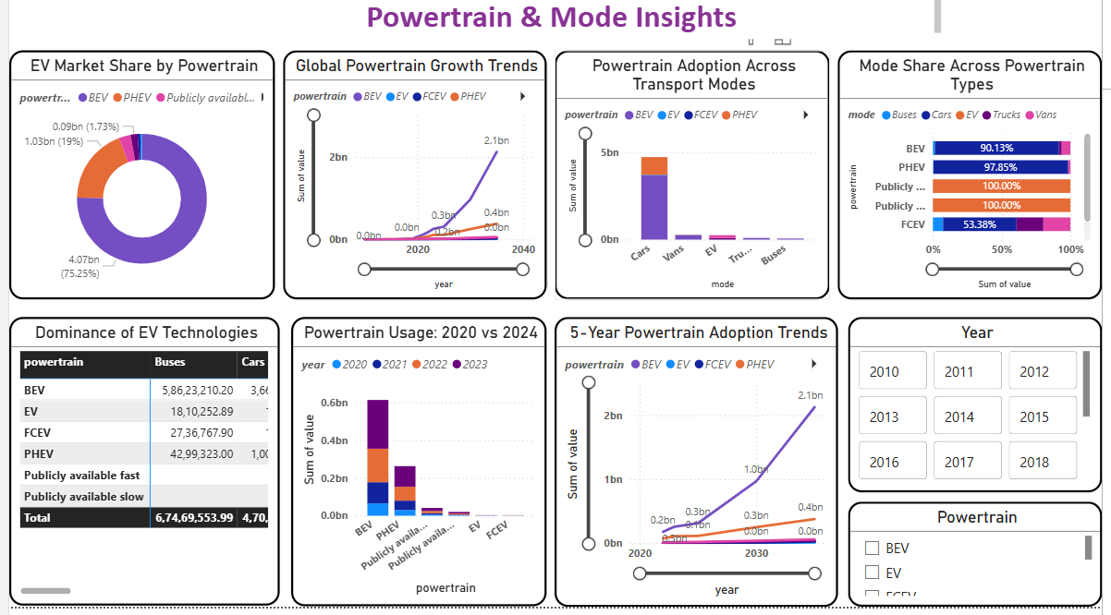
Powertrain Analysis
BEV vs PHEV trends
Fastest growing powertrain
Powertrain distribution

Slide 13
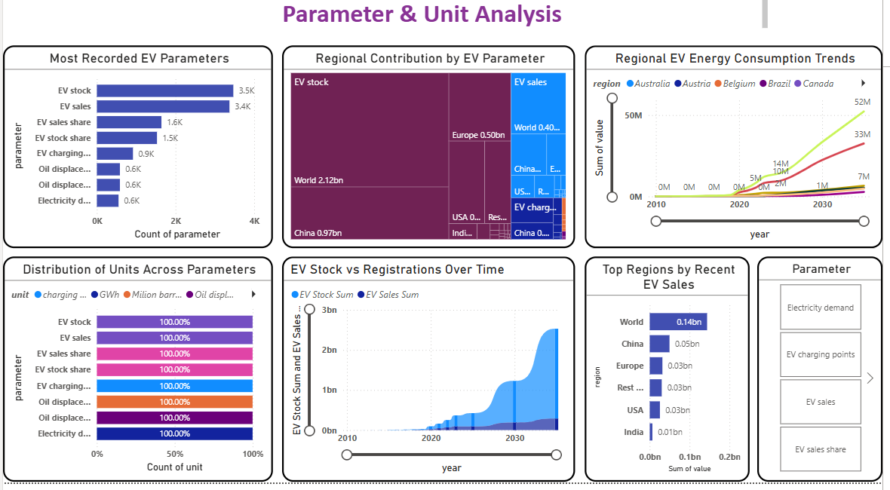
Parameter & Unit Analysis
Cars vs buses vs trucks
EV penetration across modes
Category dominance by region

Slide 14
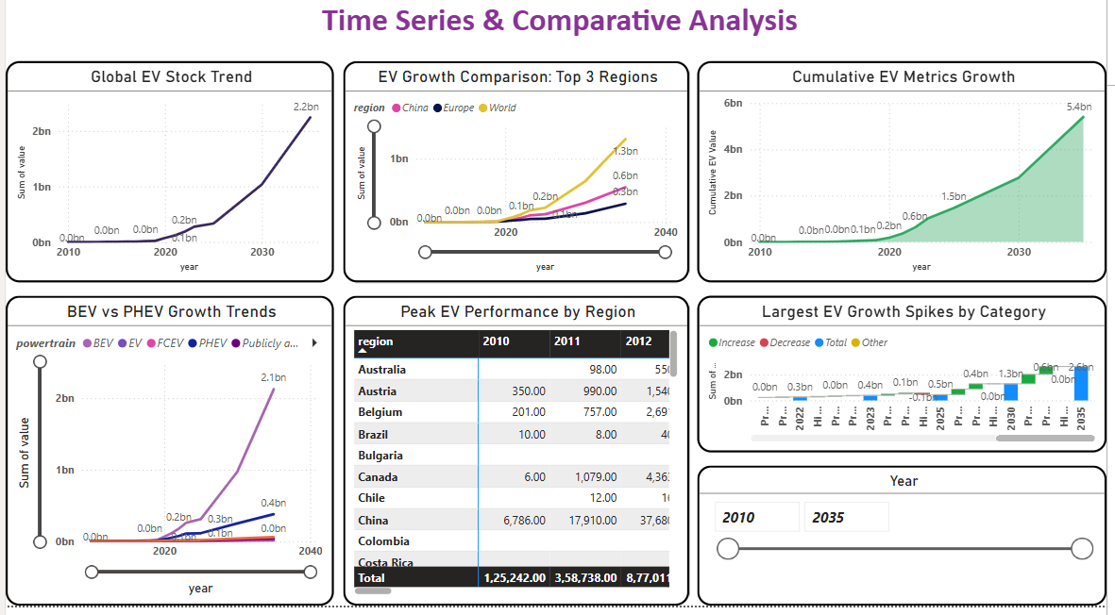
Time-Series Analysis
Year-wise EV stock growth
Cumulative EV trends
Market growth patterns

Slide 15
Business Insights and Recommendations
Key Insights
Developed regions lead EV adoption due to strong infrastructure and policy support
BEVs show the highest growth among powertrain technologies
EV sales and stock are increasing consistently over the years
Charging infrastructure growth supports higher EV adoption
Recommendations
Expand charging infrastructure in developing regions
Provide government incentives for EV adoption
Increase investment in BEV technologies
Focus on high-growth emerging EV markets

Slide 16
Conclusion
The Global EV Sales dashboard successfully transformed raw EV data into meaningful business insights using Power BI.
The project enabled:
Better understanding of EV market trends
Regional and powertrain comparisons
Interactive business analysis
Data-driven insights for decision making
The dashboard provides a scalable analytical solution for understanding the rapidly growing electric vehicle ecosystem.

Slide 17


Slide 18


